Slide 1
Principal Component Analysis (PCA)
Suman Roy
+91 - 8961153126

Slide 2
Abstract
Feature Extraction Technique.
Map Data to new Space.
New Space has REDUCED DIMENSION.
DIMENSIONALITY REDUCTION
Data Representation is more meaningful for classification or regression technique.
LOSING MINIMUM INFORMATION.

Slide 3
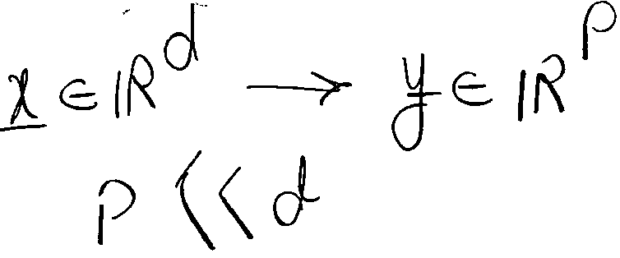
Dimensionality Reduction
Ali Ghodsi

Slide 4
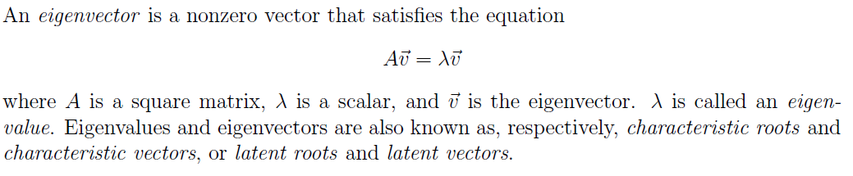
Linear Algebra
Eigenvalue and Eigenvector

Slide 5
Singular Value Decomposition (SVD)
U_{nxn}S_{nxm}V ^{T}_{mxm}= svd (X_{nxm})
U and V are orthogonal matrix i.e. U^{T}U=I, V^{T}V=I.
S is diagonal matrix.
columns of U are orthonormal eigenvectors of XX^{T}.
columns of V are orthonormal eigenvectors of X^{T}X.
S is a diagonal matrix containing the square roots of eigenvalues from U or V in descending order

Slide 6
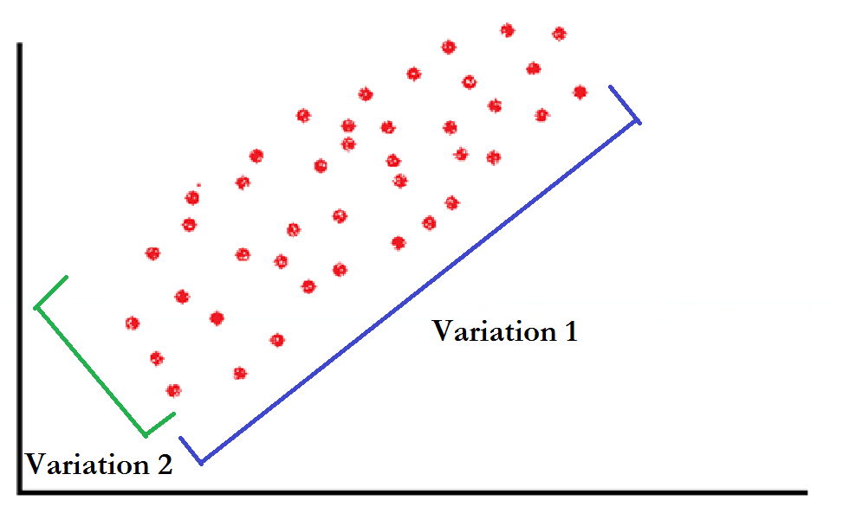
Intuition
Points are distributed over 2-d space.
There exists no 1-d subspace i.e. line such that points are placed on that line.
There exists a line such that points are close to that line.

Slide 7
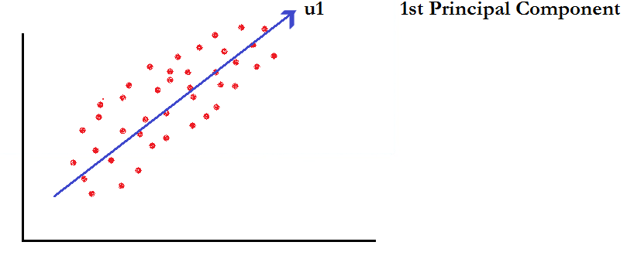
Intuition
Direction of u1 is 1st Principal Component.
Points are close to subspace/line u1.
u1 captures MAXIMUM VARIATION OF THE DATA.

Slide 8
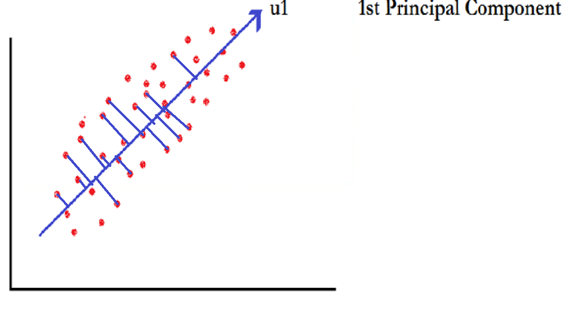
Intuition
Points are projected towards the direction where there exists MAXIMUM VARIATION OF THE DATA.

Slide 9
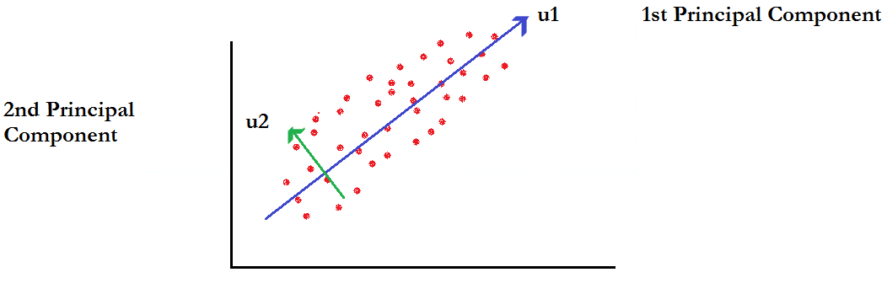
Intuition
Direction of u2 is 2nd Principal Component.
u2 captures 2nd MAXIMUM VARIATION OF THE DATA.
u2 is orthogonal to u1.
Number of Principal Component = Number of Dimension.
PCA is the representation of Coordinate system rotation.

Slide 10
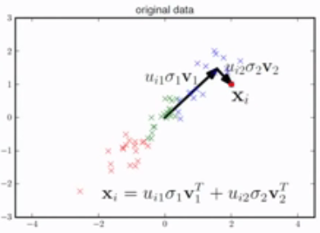
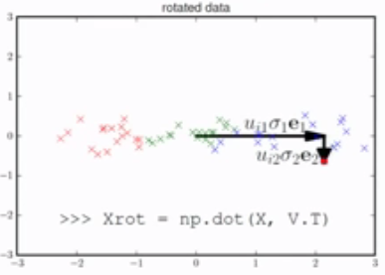
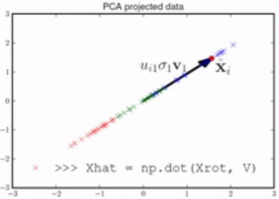
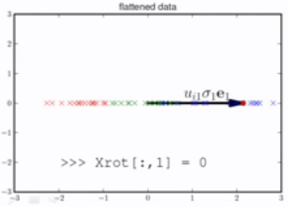
Intuition

Slide 11
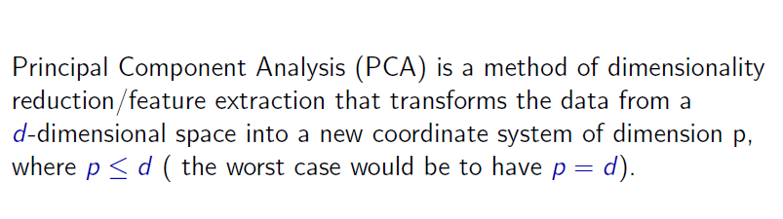
Principal Component Analysis (PCA)
Ali Ghodsi

Slide 12
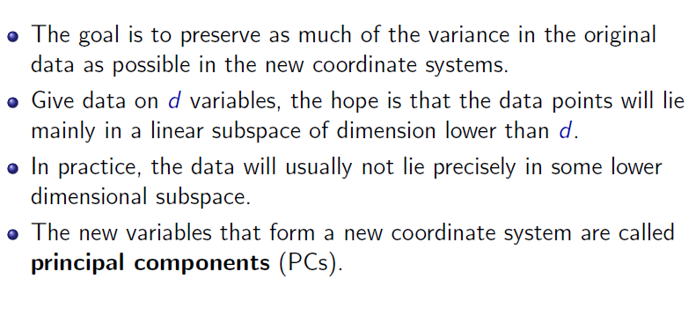
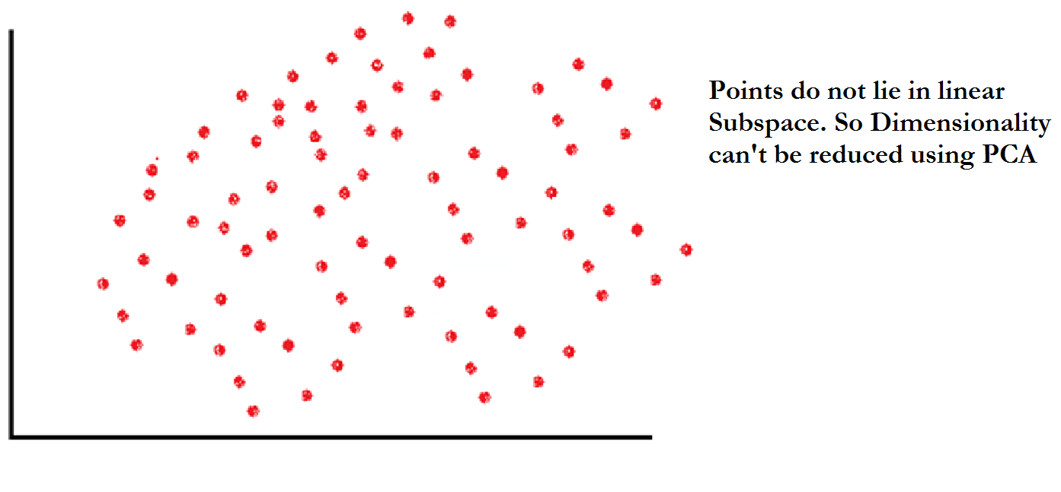

Principal Component Analysis (PCA)
Ali Ghodsi

Slide 13

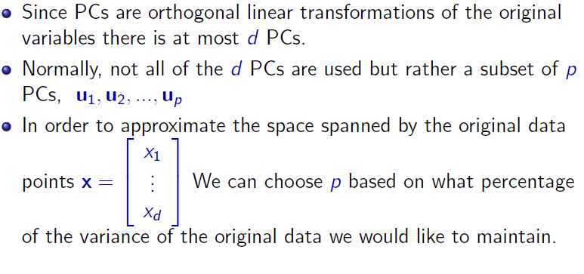
Principal Component Analysis (PCA)
Ali Ghodsi

Slide 14
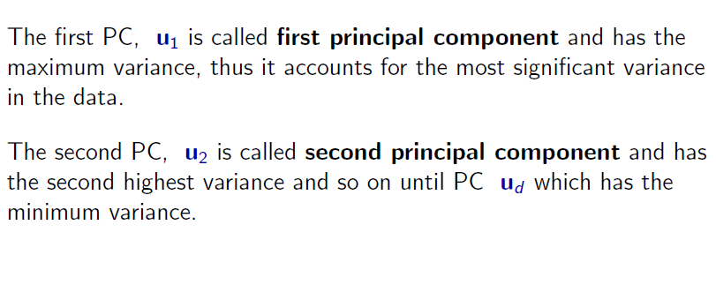
Principal Component Analysis (PCA)
Ali Ghodsi

Slide 15
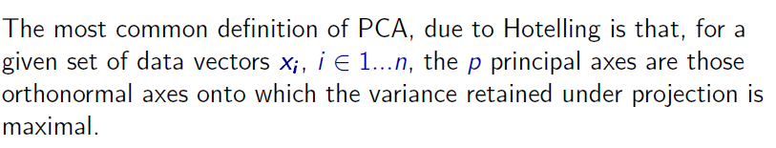
Principal Component Analysis (PCA)
Ali Ghodsi

Slide 16
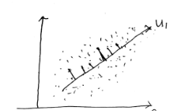
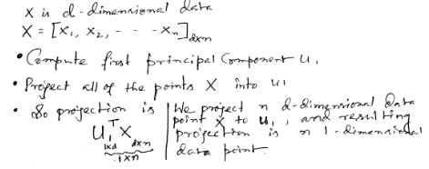
PCA Mathematical Derivation

Slide 17
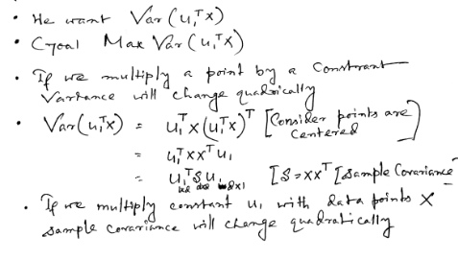
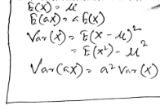
PCA Mathematical Derivation

Slide 18


PCA Mathematical Derivation

Slide 19
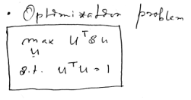
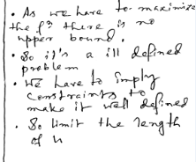
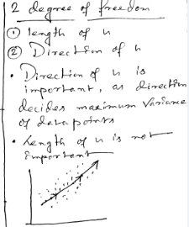
PCA Mathematical Derivation

Slide 20
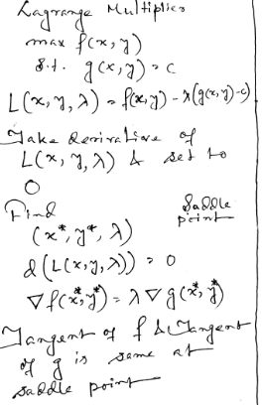
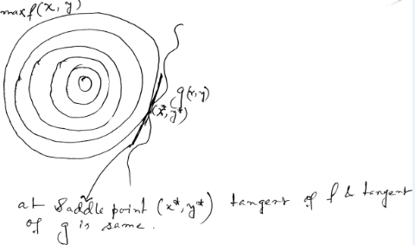
PCA Mathematical Derivation

Slide 21
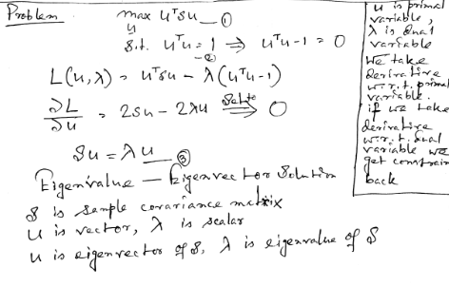
PCA Mathematical Derivation

Slide 22
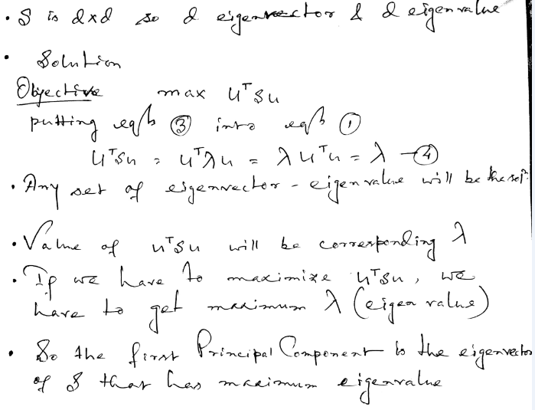
PCA Mathematical Derivation

Slide 23
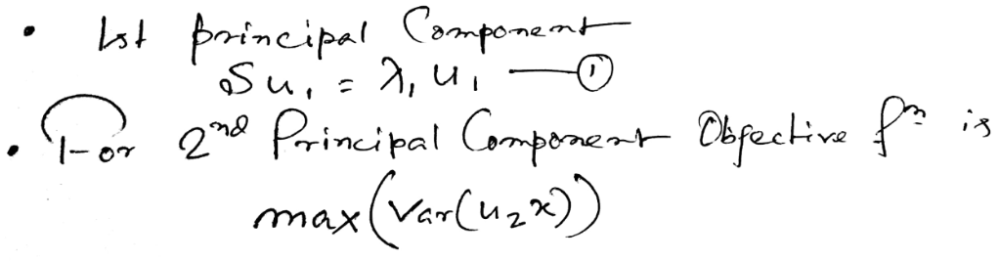
Proof of 2nd Principal Component

Slide 24
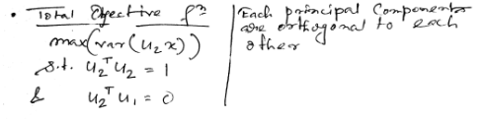
Proof of 2nd Principal Component

Slide 25
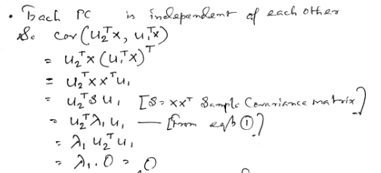
Proof of 2nd Principal Component

Slide 26
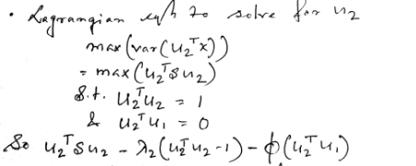
Proof of 2nd Principal Component

Slide 27
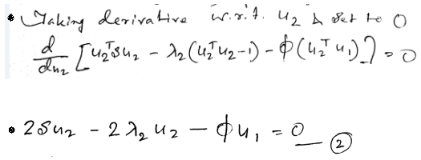
Proof of 2nd Principal Component

Slide 28
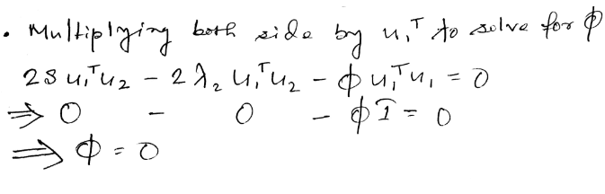
Proof of 2nd Principal Component

Slide 29
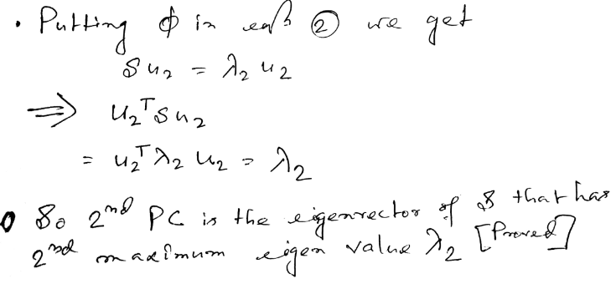
Proof of 2nd Principal Component

Slide 30
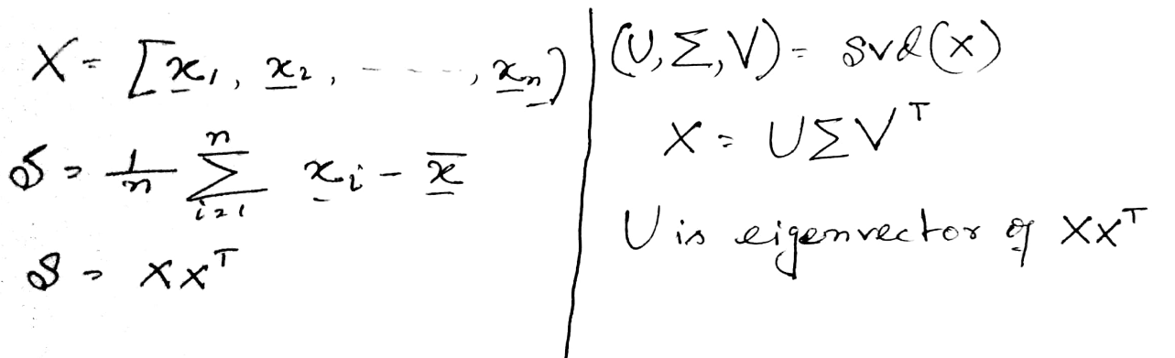
Implementation of PCA
U is Principal Component.

Slide 31
Implementation of PCA
USING OCTAVE
Ali Ghodsi

Slide 32
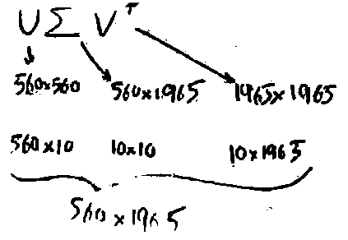
Implementation of PCA
Ali Ghodsi

Slide 33
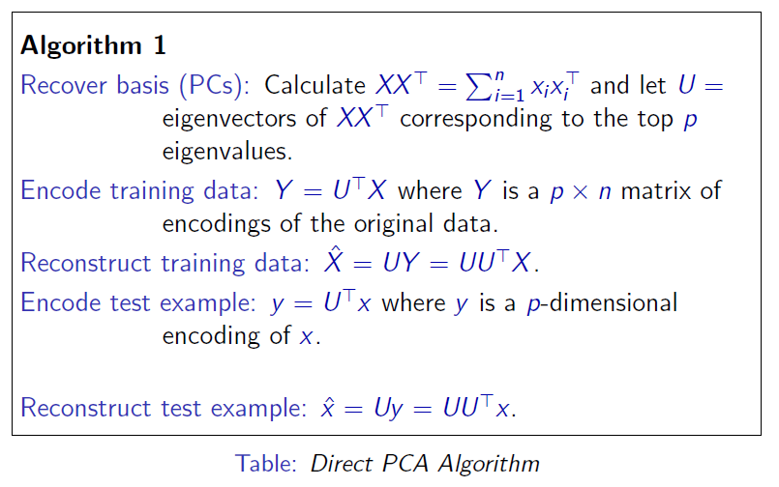
PCA Algorithm
Ali Ghodsi

Slide 34
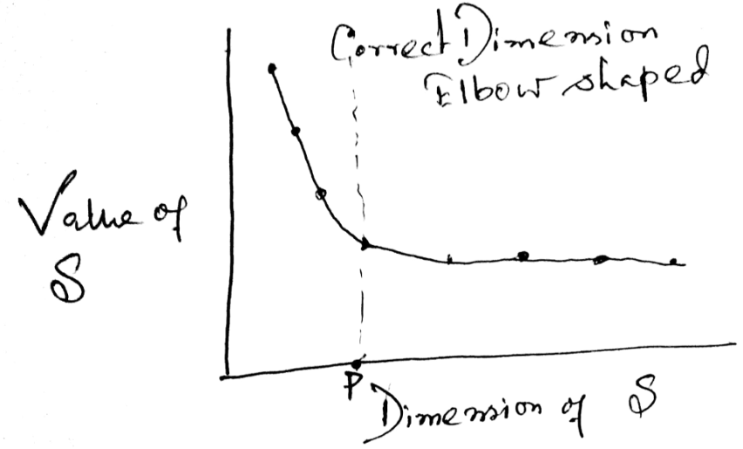
Finding Correct Dimension in PCA

